Slide 1
Statistical Methods for Data Analysis
Multivariate discriminators with TMVA
Luca Lista
INFN Napoli

Slide 2
Purpose of TMVA
Provide support with uniform interface to many Multivariate Analysis technologies:
  Rectangular cut optimization (binary splits)
  Projective likelihood estimation
  Multi-dimensional likelihood estimation (PDE range-search, k-NN)
  Linear and nonlinear discriminant analysis (H-Matrix, Fisher, FDA)
  Artificial neural networks (three different implementations)
  Support Vector Machine
  Boosted/bagged decision trees
  Predictive learning via rule ensembles (RuleFit)
The package is integrated with ROOT distribution
Helper tools for visualization provided

Slide 3
Variable preprocessing
For each classifier, a variable set (optional, but default) preprocessing can be applied
Variables can be normalized to a common range
Linear transformation into:
  Uncorrelated variable set
  Principal components (projection along axes with maximum variance)

Slide 4
TMVA Factory
All the main TMVA objects are managed via a factory object
  TFile out("tmvaOut.root", "RECREATE");
  TMVA::Factory * factory =
  new TMVA::Factory("<JobName>", &out,"<options>");
out is a ROOT writable file that will be filled by TMVA with histograms and trees
JobName is the conventional name of the job
Options allow:
  verbosity (“V=False”)
  colored text output (“Color=True”)

Slide 5
Specify training and test samples
Input files can be specified as ROOT trees or ASCII files
If signal and background are saved into different trees:
  TTree * sigTree = (TTree*)sigSrc->Get(“<SigTreeName>”);
  TTree * bkgTreeA = (TTree*)bkgSrc->Get(“<BkgTreeNameA>”);
  TTree * bkgTreeB = (TTree*)bkgSrc->Get(“<BkgTreeNameB>”);
  TTree * bkgTreeC = (TTree*)bkgSrc->Get(“<BkgTreeNameC>”);
  Double_t sigWeight = 1.0;
  Double_t bkgWeightA = 1.0, bkgWeightB = 1.0,
  bkgWeightC = 1.0;
  factory->AddSignalTree(sigTree, sigWeight);
  factory->AddBackgroundTree(bkgTreeA, bkgWeightA);
  factory->AddBackgroundTree(bkgTreeB, bkgWeightB);
  factory->AddBackgroundTree(bkgTreeC, bkgWeightC);

Slide 6
Alternative input specification
Specify cuts to select signal and background events
  TCut supported (string cut, e.g. “signal=1”)
  E.g.: based on flags in the tree
  TTree * inputTree = (TTree*)src->Get(“TreeName”);
  TCut sigCut = ...;
  TCut bkgCut = ...;
  factory->SetInputTrees(inputTree, sigCut, bkgCut);
Specify input from ASCII files:
  // first file line must be variable specification
  // in ROOT standards. E.g.: x/F:y/F:z/F:k/I
  // next lines ordered variable values
  TString sigFile(“signal.txt”);
  TString bkgFile(“background.txt”);
  Double_t sigWeight = 1.0, bkgWeight = 1.0;
  factory->SetInputTrees(sigFile, bkgFile,
  sigWeight, bkgWeght);

Slide 7
Selecting variable for MA
Variables or their combination supported
  Using ROOT TFormula
  factory->AddVariable(“x”, ‘F’);
  factory->AddVariable(“y”, ‘F’);
  factory->AddVariable(“x+y+z”,‘F’);
  factory->AddVariable(“k”, ‘I’);
Variable type specified with (optional) characted code: F=float or double; I=int, short, char; also unsigned
Weights can be computed from variables in the tree:
  factory->SetWeightExpression(“<weightExpression>”);
Normalization of a variable in the range [0, 1] can be specified with the Boolean option Normalise.

Slide 8
Prepare training data
Data internally copied and split into a training tree and a test tree
  User can specify the size of both training and test samples
  TCut presel = ...;
  factory->PrepareTrainingAndTestTrees(presel,
  “<options>”);
Options list
  Sample size can be specified via: NSigTrain=5000:NBkgTrain=5000:NSigTest=5000:NBkgTest=5000
  Default (0) means: all (remaining) events taken
  SplitMode specifies how to extract trainig and sample (Block; Alternate; Random, setting seed with SplitSeed=123456)

Slide 9
Booking classifiers
Different classifiers can run and be compared within the same TMVA job
Classifiers should be booked in advance, specifying their configuration in the option string
  factory->BookMethod(TMVA::Types::kLikelihood,
  “LikelihoodD”,
  “H:!TransformOutput:Spline=2:\
  NSMooth=5:Preprocess=Decorrelate”);
Specific options for each classifier exist

Slide 10
Train and test classifiers
All classifiers can be trained at once
  factory->TrainAllMethods();
After training, tests can run and be saved to output file for visualization
  factory->TestAllMethods();
Performance evaluation (efficiencies, ecc.) can be done afterwards:
  factory->EvaluateAllMethods();

Slide 11
Apply your trained classifiers
Instantiate TMVA reader:
  TMVA::Reader * reader = new TMVA::Reader();
Define the input variables
  The same and in the same order as for the training!
  Float_t a, b, c;
  reader->AddVariable(“a”, &a);
  reader->AddVariable(“b”, &b);
  reader->AddVariable(“c”, &c);
Book classifiers, reading output weight files
  reader->BookMVA(“<classifierName>”, “weights.txt”);
Evaluate classifiers given the variable set
  a = 1.234; b = 1.000; c = 10.00;
  Double r = reader->EvaluateMVA(“<classifierName>”);

Slide 12
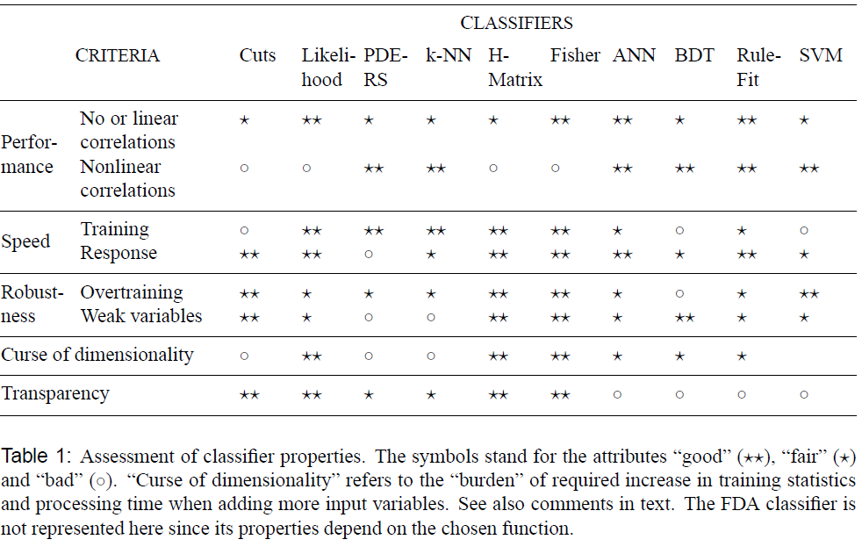
Classifier ranking in TMVA

Slide 13
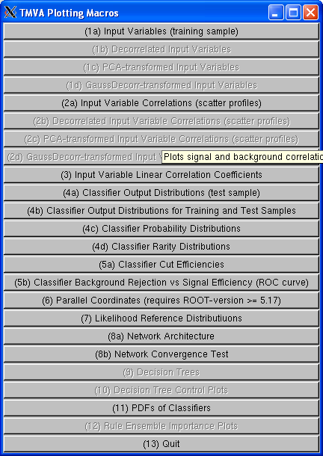
TMVA GUI macro
TMVAGui.C comes with TMVA distribution
From ROOT prompt:
> TMVA::TMVAGui(“myFile.root”)
Click on the desired plot option

Slide 14
References
TMVA User Guide
  CERN-OPEN-2007-007
  arXiv physics/0703039
TMVA
  http://tmva.sourceforge.net/

